Slide 1

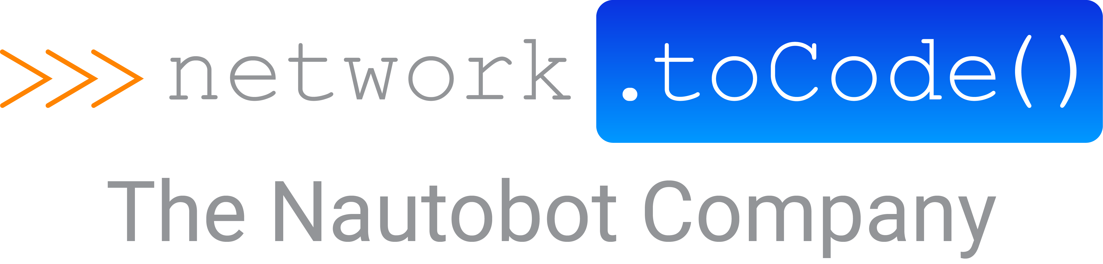

Network to Code
Choose Your Own
AI Adventure
A guide to the LLM landscape for networking.
Eric Chou · Network Automation Advocate · Network to Code
Notes:
No single right answer, on a spectrum
Pick the one that fits your situation and needs
In short, what can we do in this AI age so we can sleep at night ☺

Slide 2
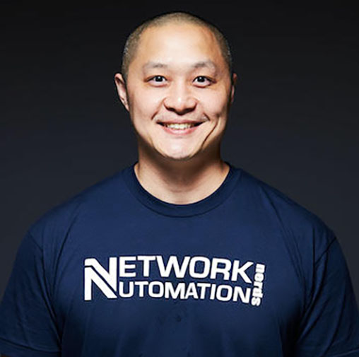
$ whoami
SPEAKER
Eric Chou Network Automation Advocate · Network to Code
Network engineer turned automation person, now AI Enthusiast
Author, blogger, Podcaster
This talk is not a sales pitch.
Notes:
Network Automation Advocate at Network to Code.
I've been doing this network automation thing for a while, which is a polite way of saying I've broken a lot of networks
Author, blogger, podcaster
Today is not a sales pitch.

Slide 3
$ agenda.md
PART 01
PART 02
PART 03
PART 04
Overview
The Landscape
The Path
Closing
Hype vs. reality. Why "just let the AI do it" doesn’t work.
Hosted, local, hybrid.
Four steps. Trust → Engineering → Integration → Evolution.
Framework. Two rules. Q&A.
Set expectations
what’s out there
thing you can do now
Next steps
Notes:
What we will talk about today: Overview, Landscape, The Path, Summarized in closing

Slide 4
PART 01 / 04
›› §1 / OVERVIEW
The hype vs. the reality.
Network engineers don't want magic. They want the phone to not go off.
Notes:
Context: - network engineers are one of the most, if not the most, risk adverse bunch.
We might choose a 2am maintenance window over continuous integration to minimize the risk
Network engineers just don’t want to ring to go off (confession: that ‘phone’ actually read ‘pager’ in first draft)

Slide 5
$ diff hype.md reality.md
— HYPE
+ REALITY
The phone rings at 2 a.m., do you trust it and ‘why not’?
"Just 'fix my BGP'"
AI is useful, but the demo and the day-job are not the same thing.
Notes:
Why ‘Just fix my BGP’ does not work? – This is the demo, art of the possible.
Trust. We can’t use anything we don’t understand, we haven’t used enough, and catch us when all failed.

Slide 6
$ echo $RISK_TOLERANCE
Network engineers are extremely risk-averse. Many of us would rather take the 2 a.m. maintenance window to do a production change.
A FAMILIAR PATTERN
WALK
RUN
FLY
We did this with scripts. We did this with Ansible and Python.
“The opposite of fragile is not resilience, it is antifragile.”
– Dr. Nassim Taleb
AI is no different. It's a tool. Treat it like one.
Notes:
We have to design around if any of this is going to help us.
Opportunities and Landmines. Same table. Same tool. Pick it up wrong and you lose a finger.
We have done it before: Python, Ansible, vendor tools.
Fragile: breaks under stress of volatility
Resilient: withstand stress and stays the same
Antifragile: Actually improves, grows, and thrives because of volatility.
This is our Antifragile moment.

Slide 7
PART 02 / 04
›› §2 / THE LANDSCAPE
Starting Point on the map.
Hosted, Local, Hybrid
Notes:
We will never get to our destination if we don’t know where we are going
We need a map, and the starting point on that map is to understand the landscape

Slide 8
$ llm-landscape
▢ 01
▢ 02
▣ 03
Hosted
Local
Hybrid
Anthropic Claude
OpenAI GPT
Ollama
Llama
Qwen
Mistral
Routed by task
AWS Bedrock
Gemini
Azure AI Foundry (Studio)
You rent. State of the art. Your prompts traverse someone else's data center.
You own it. Data never leaves the building. You also now run an inference stack — congrats, you're an AI ops team.
Sensitive ↦ local. Generic ↦ hosted. One API surface, multiple backends.
Notes:
All services start with the models.
Generally speaking, we can categorize the LLMs into three buckets:
Hosted
Local
Hybrid

Slide 9
$ ./hosted --rent
WHAT IT IS
THE CATCH
The big public APIs. Claude. GPT. Gemini. You don't run them; you call them.
Your prompts and configs go through someone else's data center.
Your security team will have a strong opinion. They are correct to.
The strongest models, by a meaningful margin.
Cost is per-token. Easy to start, easy to surprise yourself.
Zero infra. An API key and a OpEx budget.
You don't control the model.
State of the art moves about every six weeks. You get the upgrade for free.
Best for: prototyping, generic tasks, anything where the data isn't sensitive.
Notes:
- Hosted models are what most of us started
Least friction, but restricted by providers
Our trust and guardrails are limited to what is available to us (prompt, restrictions, collaborations)
We don’t control it, the model can be gone tomorrow.

Slide 10
$ ./local --own-the-box
WHAT IT IS
THE CATCH
Ollama plus open weights. Llama, Qwen, Mistral, etc. The model runs on a box you control.
You now run the stack. Quantization, batching, scaling, on-call.
You will be a model version behind — sometimes a few.
Capability gap on hardest tasks: real, narrowing, not zero.
Data never leaves. Regulatory headaches go from existential to manageable.
Hardware CapEx isn't free either — that GPU has a depreciation schedule.
Predictable cost. You bought the GPU once. The token meter doesn't tick. CapEx.
Open weights the ‘mathematical weights’ are public, but source code and trained data are still private.
Best for: regulated data, deterministic cost, anything that can't leave the building.
Notes:
- Local models: you own it, but you break it you fix it too

Slide 11
$ ./hybrid --route-by task
WHAT IT IS
A PICTURE
Routed by task or sensitivity. Often through AWS Bedrock , Azure AI Foundry, or a thin router you write yourself.
USER PROMPT
→
ROUTER classify · score · pick
LOCAL sensitive / regulated
HOSTED generic / capability
Sensitive customer configs ↦ local model, in-VPC.
Boilerplate, scaffolding, summarization ↦ hosted model, best in class.
One API surface. Your application code doesn't know which backend it hit.
More Difficult to get started.
Notes:
- Hybrid: AWS / Azure, use other’s model but a rented hardware

Slide 12
$ ./pick --with-honestly
01
02
03
04
Data sovereignty & regulation
Cost OpEx vs. CapEx
Skills & comfort level
Availability & blast radius
Can your configs and customer data leave the building? Sometimes the answer is "no" and that's the whole decision.
API tokens scale linearly with use. Hardware is a one-time bite with a five-year tail. They look different on different spreadsheets.
Hosted is a billing problem. Local is an operations problem. Hybrid is both.
Public APIs go down. So do internal ones.
› Where does this data have to live?
› What breaks when the model is gone?
› Whose budget is this?
› Who's on-call for this?
Notes:
- Decision criterias

Slide 13
PART 03 / 04
›› §3 / NEXT STEPS RECOMMENDATIONs
Next steps. In order.
Trust, Engineering, Integration, then Evolution.
Notes:
Once we picked our starting point, the next step is to start the process.
Restricted by last step, of course
But also some evergreen process: Establish trust, Engineer for the better, Integrate into tools and processes, then feedback.

Slide 14
$ cat ./path.map
STEP 01
STEP 02
STEP 03
STEP 04
Trust & Guardrails
Engineering
Integration
Evolution & Feedback Loop
— pick your model, write your rails
— beyond the magic trick
— co-pilot, not autopilot
— make it learn
Zero-shot vs. few-shot vs. RAG. Deterministic, schema-validated output. Confidence scoring.
The Ideation → Review → Validation → Approval → Execution pattern.
Human expert review of misses. System validation of outputs. AI evaluating other AI as a second-opinion layer.
Decide hosted / local. Establish prompt hygiene. Build the logs and traces.
Notes:
Going one step further
Trust & guardrails
Engineering
Integration
Feedback and Evolve

Slide 15
$ STEP 01 — Trust & Guardrails
DECISION
PRACTICE
INSTRUMENTATION
Hosted or local
Prompt hygiene & Guardrails
Visibility & traces
Pick. Or accept that your security team has already picked for you, this determines your next step.
What you put in. How it's structured. What never goes in. System prompt or other restriction files.
Log calls. Capture prompt, model, version, response, latency, cost.
Notes:
Your trust and guardrails depend on where your models are
Prompt engineering
Establish logs and traces

Slide 16
$ STEP 02 — Engineering
Example: perfect your data and prompt (input).
A
B
C
Zero-shot
Few-shot
RAG
› TRIVIAL · STATELESS · GENERIC
› YOU HAVE 5 EXAMPLES OF RIGHT
› ANSWER LIVES IN YOUR DOCS / CMDB
prompt: "Rewrite this
interface description in
plain English."
examples: - input: …
output: …
- input: …
output: …
now do: …
retrieve: top-k chunks stuff: into context ask: grounded question cite: sources back
Notes:
- Engineer the inputs

Slide 17
$ STEP 02b — More Engineering
Data Input and Output
Focus on data and results (output)
Structured output mode — ingestible data output
Sanity checks on values — IP in subnet? Interface exists? VLAN in range?
Schema-validate Reject malformed responses; retry with a stricter prompt.
Confidence scoring — evaluation. Below threshold ⇒ human.
Notes:
- Validate the outputs

Slide 18
$ STEP 03 — Integration with Tools
GLUE
FRONTEND
GOAL
LangChain …or plain Python.
Streamlit …or Gradio, or a quick web UI.
A Network Co-Pilot
Chain calls. Manage memory. Tool-use. Whatever framework lets you describe a pipeline as a pipeline instead of nested if-statements.
Humans need somewhere to see what the thing is doing. The goal is not beautiful — the goal is legible . A textarea, a diff, a button.
A human sits next to it.
Notes:
- Integration with other tools

Slide 19
$ STEP 04b — Integration with Process
Don't trust. Always validate.
› AI
› HUMAN
› SYSTEM
› HUMAN
› SYSTEM
Ideation
Review
Validation
Approval
Execution
Model proposes. Schema-validated JSON, candidate intents, candidate config.
An engineer reads it. Eyes on the diff. First sanity check.
Linter. Schema check. Dry-run. Diff against intent. Policy engine.
A named person clicks the button. Their name on the change ticket.
And only now does anything touch a device. Push. Verify. Roll back if drift.
▣ Two human gates. Both required. Both named.
▲ Execution is the last 10% of the pipeline and 90% of the risk.
Notes:
- Integrate with process

Slide 20
$ STEP 04 — evolution & feedback
…you layer on the feedback loop
Human expert reviews the misses.
Code & system validation test cases, digital twin, etc..
AI Evaluation optimized for speed, cost, or accuracy.
Notes:
- Establish feedback loop (AI Eval)

Slide 21
›› §4 / SUMMARY
3-Step Decision Framework. And 2 Rules.
A 3-step decision framework, and the two rule to live by.
Notes:
- Summary

Slide 22
$ ./decide --in-three-questions
Q1
Q2
Where does the data have to live?
How complex is the task? Is it a complicated or complex problem?
Picks hosted, local, or hybrid . If your security team has an opinion, this is already answered. Be honest about regulation and sovereignty before you negotiate with yourself about cost.
Picks zero-shot, few-shot, or RAG . Default to the simplest one that works.
Trust, Engineering, Integration, Evolution
Q3
What's the blast radius if it's wrong?
Picks how many humans and how much system validation and evaluation.
Notes:
01 - Picks hosted, local, or hybrid . If your security team has an opinion, this is already answered. Be honest about regulation and sovereignty before you negotiate with yourself about cost.
02 - Picks zero-shot, few-shot, or RAG . Default to the simplest one that works. Every layer past that costs you tokens, latency, and a debugging surface area you will eventually regret.
03 - Picks how many humans and how much system validation and evaluation. sit between the model and the change. Read-only chatbot — light touch. Production config push — every gate on this deck. The rest is engineering.
AI evaluating AI deserves its own moment. The proposer model is optimizing for plausible. The critic model can be prompted to optimize for paranoid. Different system prompts, different temperatures, sometimes different models entirely. You'll catch a category of mistakes the proposer was never going to catch on itself. It is not a replacement for the human in the loop. It is another layer of cheese in the swiss cheese model.

Slide 23
$ cat ~/.rules
01
02
No AI-generated anything touches production without a human approval.
Start small. Iterate.
CHOOSE YOUR OWN AI ADVENTURE
24 · RULES
Notes:
- 01. Not "usually." Not "for low-risk changes." Not "after-hours when you're tired." None. A named human, a click, a ticket. Every time. This rule survives every architecture change.
- 02. Pick one workflow. Make it boring and reliable. Then pick the next one. The teams getting eaten alive by this technology are the teams who tried to do everything at once. Boring wins.

Slide 24

“The opposite of fragile is not resilience, it is antifragile.”
– Dr. Nassim Taleb
Questions?
Eric Chou — Network Automation Advocate, Network to Code
› LinkedIn
https://www.linkedin.com/in/choueric/
Notes:
Fragile: breaks under stress of volatility
Resilient: withstand stress and stays the same
Antifragile: Actually improves, grows, and thrives because of volatility.
This is our antifragile moment
Treat AI like a tool - solve complicated problems and not complex problems

